Slide 1
Health & Wellness Committee
Five Year Analysis
2013-2017
Shehzad Ali
City of Sugar Land Fire-EMS Intern
July 17, 2019

Slide 2
Firefighter Health and Wellness
The mission of the Firefighter Health and Wellness Committee is to provide factual data and practical guidance regarding key areas of health and wellness to educate and facilitate the development of action guides by individuals and departments.

Slide 3
Firefighter | Health a Commissioner Mala Sharma – Chair | d Wellness
Danny Kistner – McKinney Fire | Daniel DeYear – Dallas Fire Rescue | Brett Ellis – Harris County ESD #48
Doug Boeker – Sugar Land Fire Department | Scott Thompson- The Colony Fire Department | Michael Mire – Houston Fire Department
Dr. Sara Jahnke – Center for Fire, Rescue & EMS Health Research | Christopher Kahl – Portland Fire Department | Steven Green – Longview Fire Department.
Dr. Lucas Garcia - McAllen Fire Department | Homer Javier Salinas – Mission Fire Department
n

Slide 4
Five Year Analysis

Slide 5
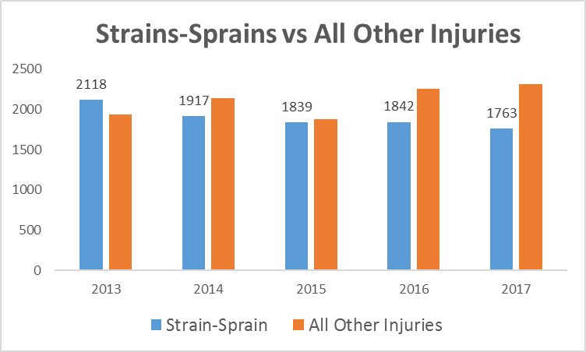
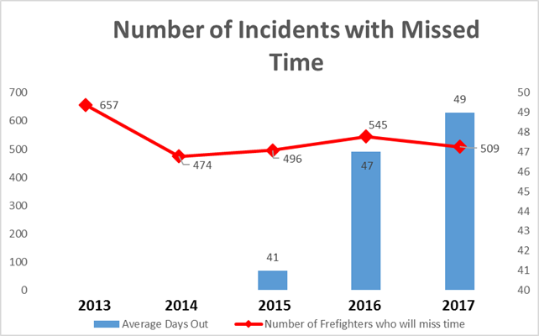
Strains and Sprains
There is an average of 1,896 strains-sprains per year. In the last five years strains-sprains have made up 47.4% of the number of total injuries.
There was an average of 536 Firefighters a year who missed time with a strain-sprains. Since 2015 Firefighters who have missed time with a sprain-strain injury were out an average of 46 days.

Slide 6
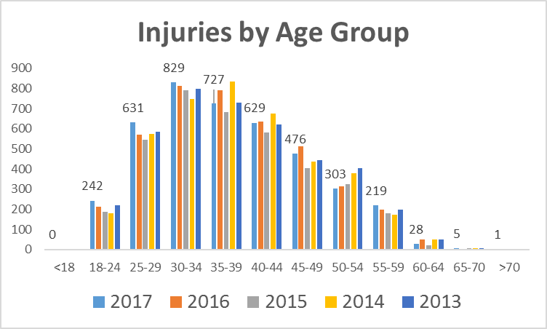
Age-Injury Correlation

Slide 7
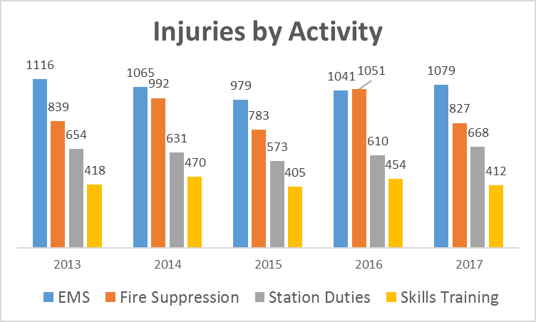
Injuries by Types of Activity
There is an average of 774 Firefighters who take time off because of an injury.
Each year there is an average of 28,588 days missed due to injury.
Equivalent to
686,112 hours missed
238 full time Firefighters off for a year

Slide 8
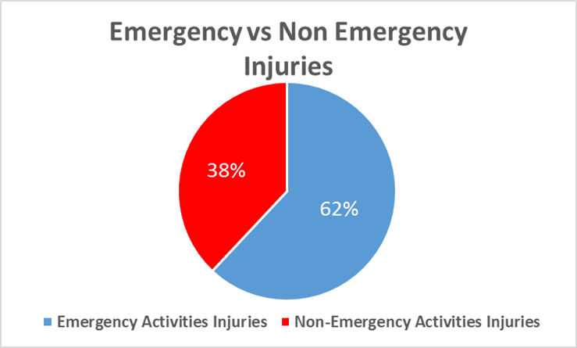
Emergency Vs Non-Emergency
List of Emergency Activities (Percentage of Total Injuries)
EMS (26.38%)
Fire Suppression (22.44%)
Rescue-Non Fire (6.15%)
Responding to Incidents (3.80%)
Rescue- Fire Related (1.12%)
Returning from Incidents (1.43%)
Hazmat (0.67%)
List of Non-Emergency Activities (Percentage of Total Injuries)
Station Duties (15.67%)
Skills Training (10.79%)
Wellness/Fitness (9.96%)
Fire Prevention (1.58%)

Slide 9
Task at Time of Injury

Slide 10
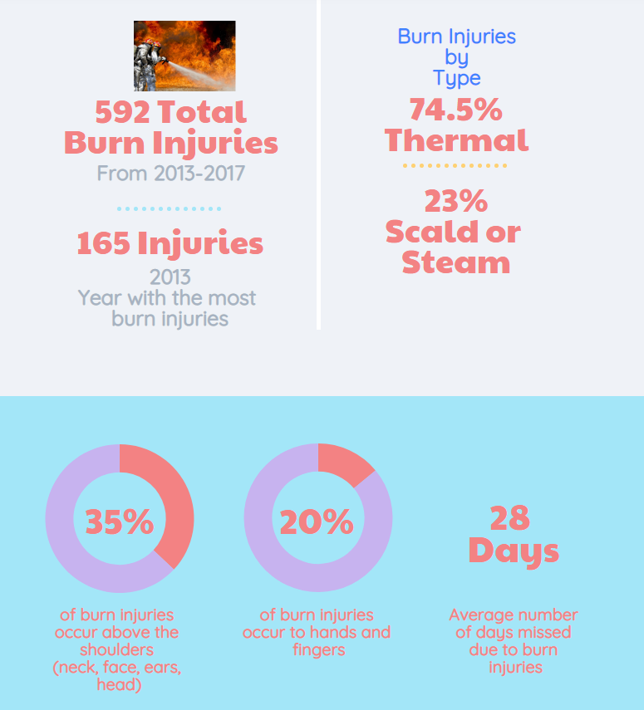
Burn Injury Report
Notes:
I am confused where the “obesity and overweight cases” came from

Slide 11
Texas Vs. United States

Slide 12
Texas vs National
Note: NFPA uses data from big and small cities but the report uses 2,592 departments to make a projection for total number of injuries in the United States.
Source: BLS Statistics, Texas A&M Forrest Service, NFPA

Slide 13
- “Fireground” includes Fire Suppression and Rescue-Fire Related
- “Non-Fire” includes Rescue Non-Fire, EMS, and Hazmat
“Other On-Duty” includes Fire Prevention, Station Duties, and Wellness/Fitness
“Responding and Returning” and “Training appear to correspond closely to the commission’s categories

Slide 14
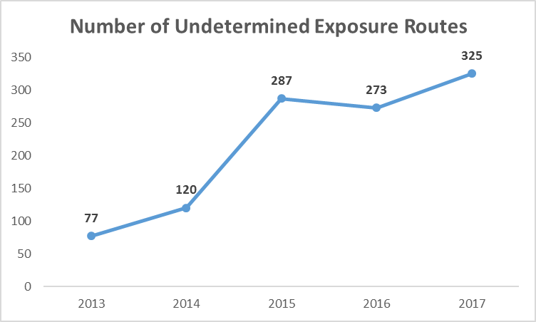
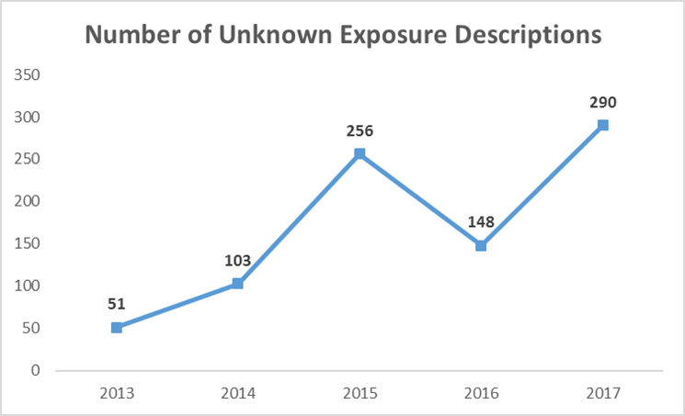
Exposures
•
•
The number of undetermined exposure routes have gone up 422% the last five years.
The number of unknown exposure descriptions have gone up 566% the last five years.

Slide 15
Firefighter Health and Wellness
Routes of exposure:
Absorption:
Modern fires are more like hazardous materials incidents. Approximately 84,000 chemicals are used in modern construction and contents.
Prolonged dermal exposure to soot. Contaminants may adhere to personal protective equipment.
Absorption increases 400% with each 5° increase in skin temperature.
Neck area is one of most common areas for exposure, angle of the jaw, and forehead.
Be Quick.
Be Smart.
Protect your head.
Source: March 2019 Health and Wellness Presentation

Slide 16
Cancer Report

Slide 17
Cancer Report
Firefighter occupational cancer is reported voluntarily.
10 reports of firefighter cancer reported to TCFP in 2017.
14 reports of firefighter cancer reported to TCFP in 2016.
Note: several Texas Fire Departments anecdotally report much higher incidence of cancer.

Slide 18
Firefighter Health and Wellness
Scope:
Cancer Type | Risk
Testicular | 2.02 (x) greater risk
Mesothelioma | 2.0 (x) greater risk
Multiple Myeloma | 1.53 (x) greater risk
Non-Hodgkins Lymphoma | 1.51 (x) greater risk
Skin | 1.39 (x) greater risk
Brain | 1.31 (x) greater risk
Malignant Melanoma | 1.31 (x) greater risk
Prostate | 1.28 (x) greater risk
Colon | 1.21 (x) greater risk
Lukemia | 1.14 (x) greater risk
Source: March 2019 Health and Wellness Presentation
Notes:
I would include at the bottom something like “Source: March 2019 Health and Wellness Presentation”

Slide 19
Firefighter Health and Wellness
Scope:
•
According to data collected by IAFF, Cancer has caused 61% of career firefighter Line of Duty Deaths since 2002.
Firefighters have a 9% higher risk of cancer diagnosis than the general population.
Firefighters are 14% more likely to die from cancer than the general population.
Estimates that 1/3 of all firefighters will experience cancer at some point in their lives.
Respiratory, digestive, and urinary cancer prevalent.
Mesothelioma among firefighters is double the reported rate for the general population.
•
•
•
•
•
Source: March 2019 Health and Wellness Presentation
Notes:
Again, add source

Slide 20
What Can We Do To Get Better?

Slide 21
Problems with Data Collection
We need to ask better questions when collecting exposure information.
Exposures make up 24.38% of total injuries but we do not gather enough data about the actual exposures.
We need to do a better job of reporting cancer data.
Move toward mandatory cancer reporting.
Injury – Illness Statistics
Average of 47 injury reports concerning chest pains-cardiac.

Slide 22
Recommendations
Recommendations
Based on their review of the data contained within this report, the commission offers the following recommendations to the Texas fire service:
◊ Improve awareness and distribution of the annual injury report by notifying fire department administrators when this and future reports are published and provide a link to the report in the notifications.
◊ Enhance program features and “usability” by providing better explanations, descriptions and definitions of terms in both the reporting module and in the annual report.
◊ Provide the Texas fire service with injury updates, perhaps on a quarterly basis, targeting trends or other issues noted during the year. This could be accomplished via postings on the agency’s website, social media platforms, or by other means.
◊ Explore options for incorporating injury data into annual continuing education opportunities for fire personnel.

Slide 23
Recommendations(cont.)
Strains-Sprains
Stretching
EMS equipment review / Patient moving
Equipment deployment / Apparatus design
Weightlifting
Review purpose of weight lifting
Review types of exercise routines

Slide 24
Recommendations(cont.)
Cancer
Consider early detection testing
Review Health & Wellness Committee Mar 2019 presentation
Read The Lavender Report
Clean everything often
Fire ground Injury Prevention
Fire Risk Analysis
Familiarity walk through
Pre-planning
Notes:
Make sure you tie this to firefighter safety. Preplanning could be useful for many purposes but here we are focusing on injuries.

Slide 25
Any Questions?

